Slide 1







PREDICTING WATER QUALITY
By Choy Jee Hung Caleb p2341475

Slide 2



Table of contents
01.
02.
03.
Data Exploration
Data Preprocessing
Model Building
04.
05.
06.
Model Evaluation
Model Improvements
Results & Conclusion

Slide 3
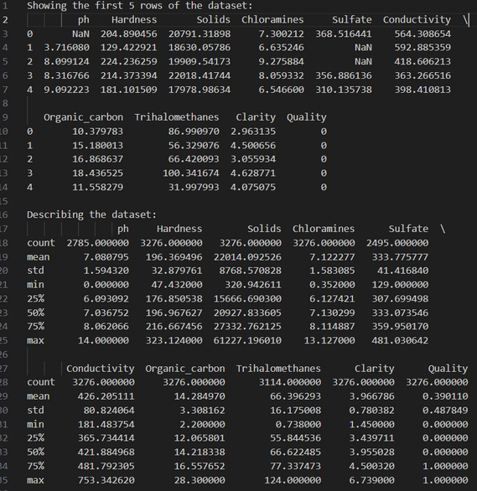
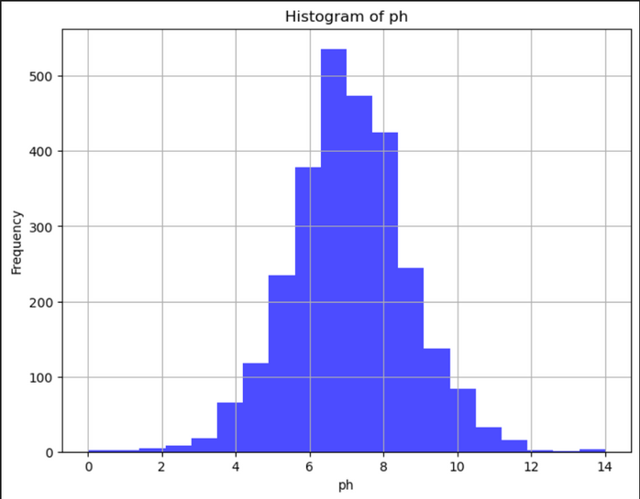
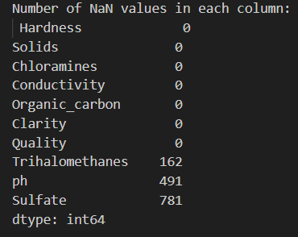
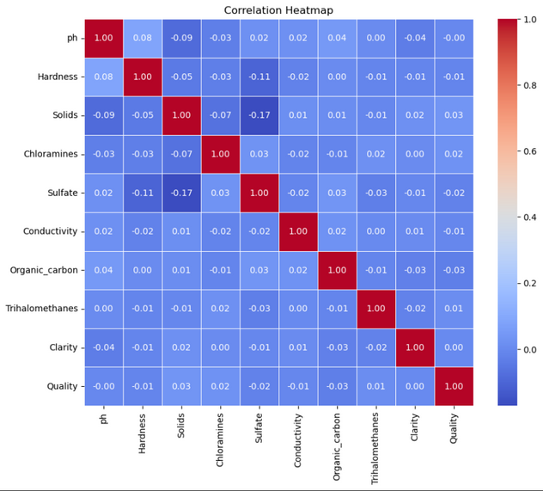

Data Exploration
To understand the structure and characteristics of the dataset.
Examine basic statistics (mean, median, standard deviation).
Visualize distributions of features to identify patterns.
Check for missing values and outliers.
Explore relationships between variables through correlation analysis.

Slide 4
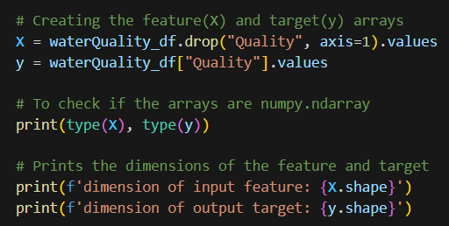
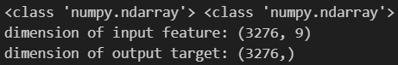
Data Preprocessing-Target/Features
The output variable/target is the variable you are trying to predict. In this case, it is the water quality.
Our prediction task is the prediction of water quality based on the properties of water.
Knowing this, we can select our target (Quality) & features (The rest of the columns).

Slide 5
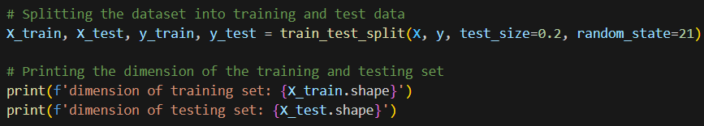
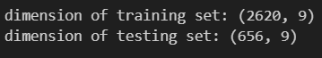
Data Preprocessing-Splitting
Splitting the dataset up into 2 different sets; Training set and Testing set for reasons such as:
Preventing Overfitting
Estimating Model Performance
Hyperparameter Tuning

Slide 6
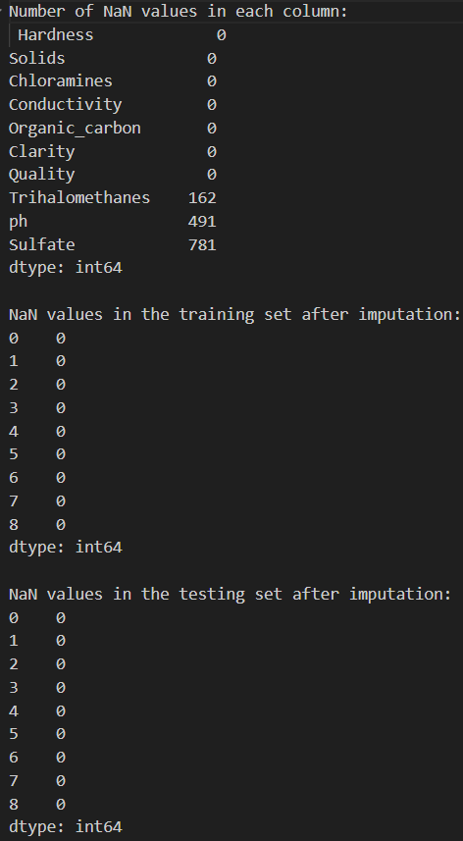
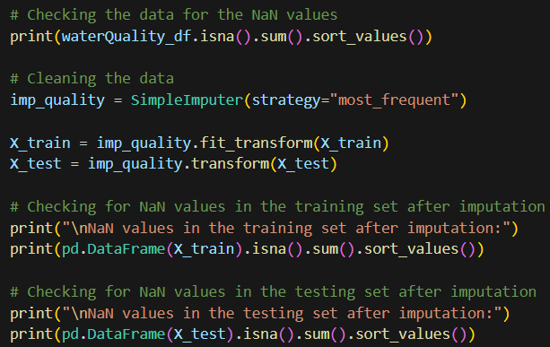
Data Preprocessing-Cleaning
Handle missing data by imputation or removal.
Detect and address outliers, considering whether they were genuine data points or errors.
Reminder to split the dataset before cleaning in order to prevent data leakage!

Slide 7
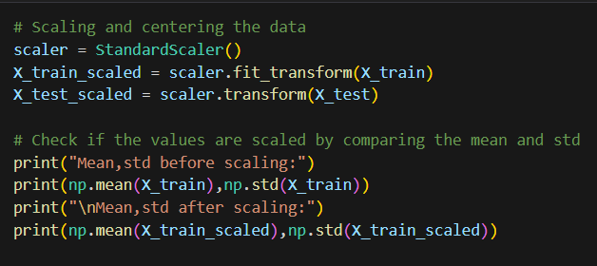
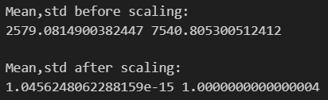
Data Preprocessing-Normalization/Standarize
Standardized or normalized numerical features to ensure consistent scales. Some learning models such as KNN, benefit from better accuracy by doing this step since they are sensitive to outliers and large ranges of data.

Slide 8

Classification learning models used
01
02
03
04
05
Naïve Bayes Classifier
Support Vector Machines
Random Forest Tree
Logistic Regression
K-Nearest Neighbours

Slide 9
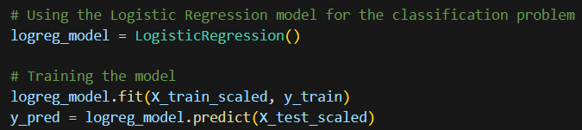
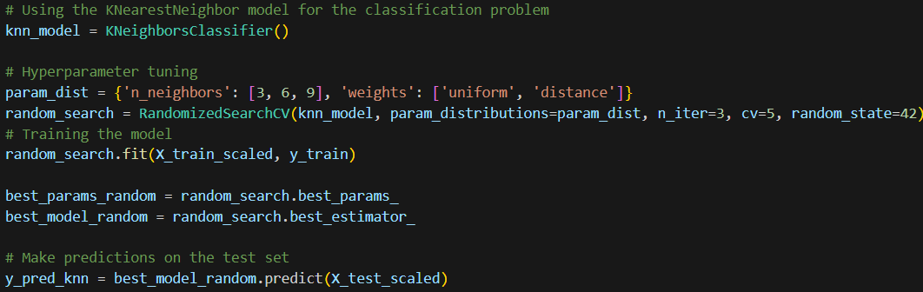
Model building
Train models on the training data by fitting the data to the model.
For example, a fit on the Logisitic Regression Model,
Or, with some hyperparameters such as the one done in this K-Nearest Neighbour Model,

Slide 10
Model Evaluation-Predict
Evaluate models on the testing data by predicting the data on the model.
For example, on the Logisitic Regression Model,
Or, after adding hyperparameters such as the one done in this K-Nearest Neighbour Model

Slide 11
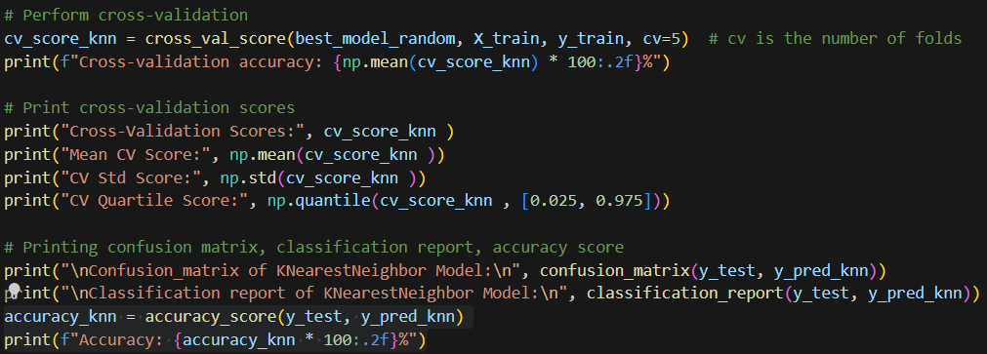
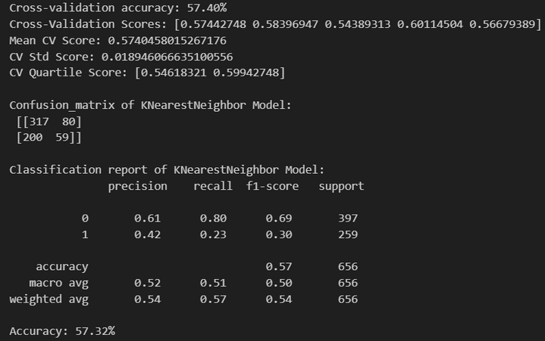
Model Evaluation- Scores,reports&Matrix
Evaluate models by utilizing common evaluation metrics such as Cross Validation, Confusion Matrix, Classification Report and Accuracy scores.
For example, in the case of the KNN model,

Slide 12
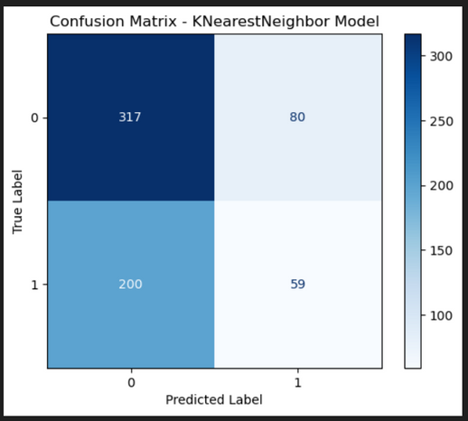
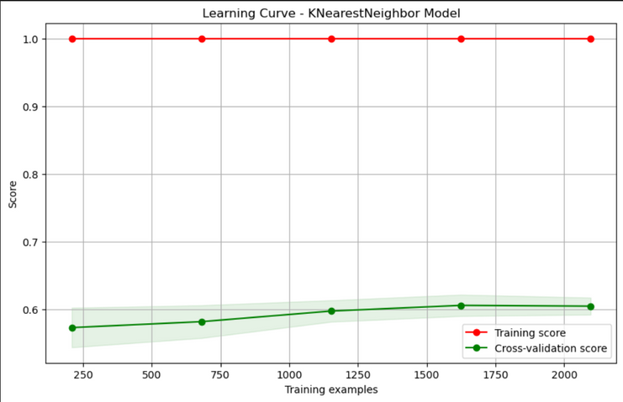
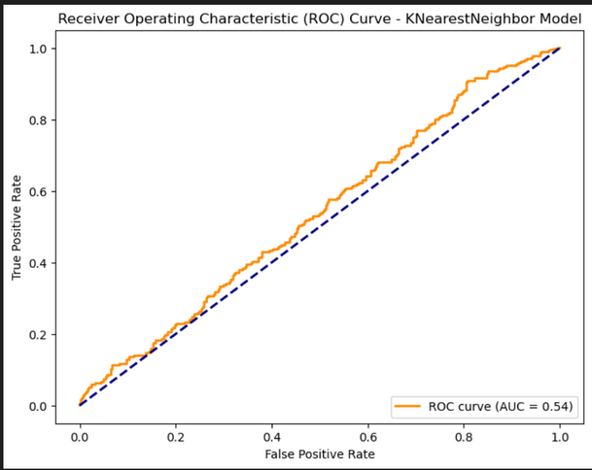
Model Evaluation-Visualization
Evaluate models easily and more user friendly by utilizing visualization methods to display Confusion Matrics, Learning curve, ROC, AUC, etc
For example, in the case of the KNN model,

Slide 13
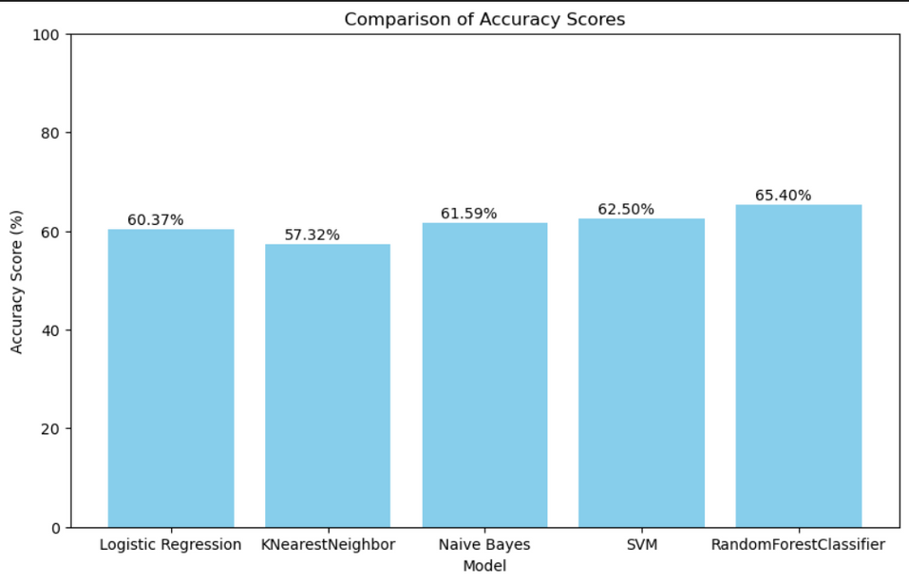
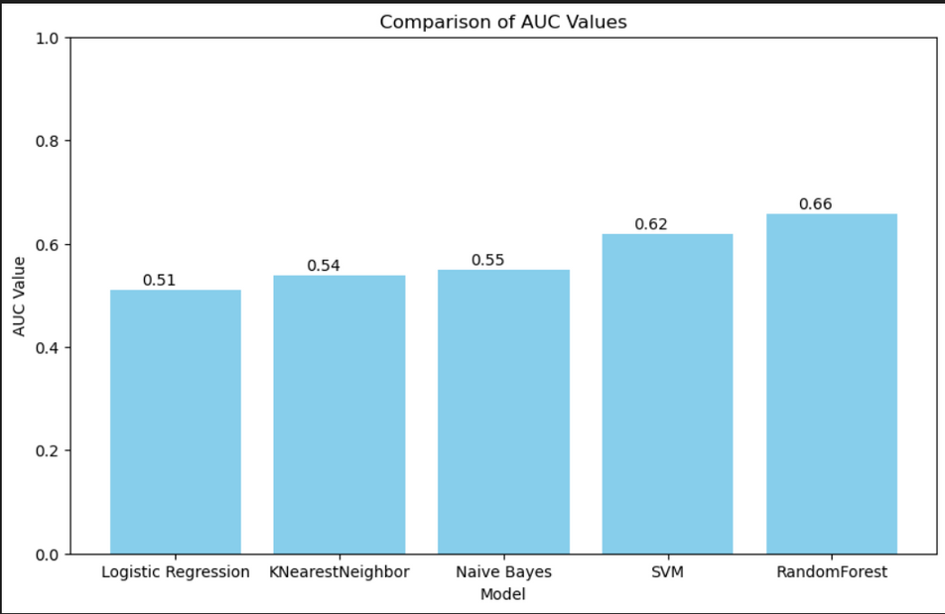
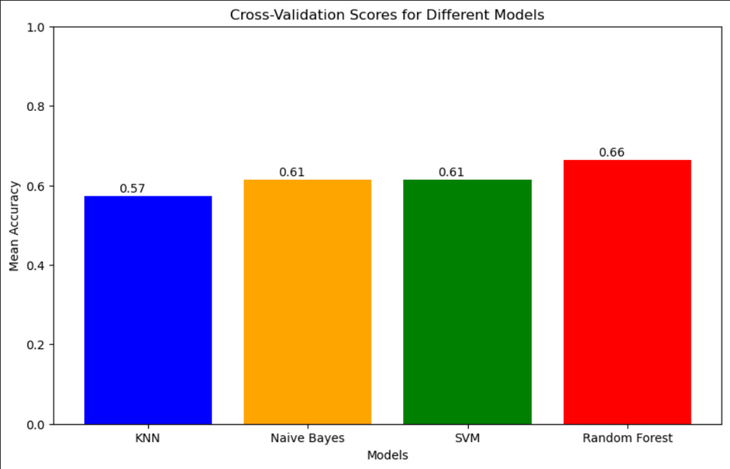
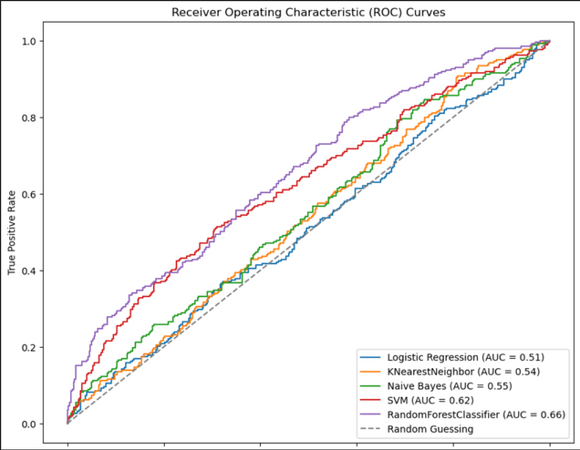
Model Evaluation-Visualization
You can also compare all models easily by plotting them in a single graph:

Slide 14
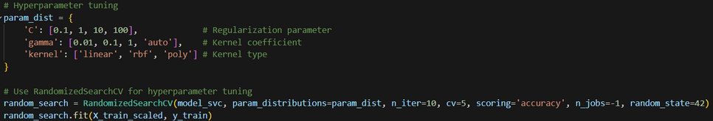
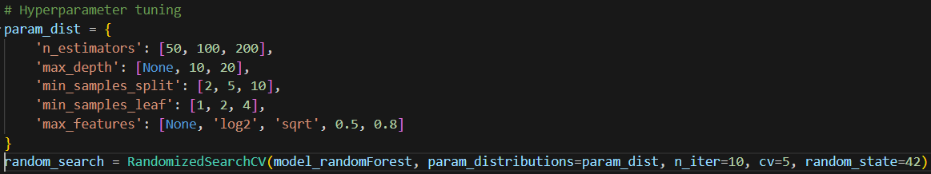
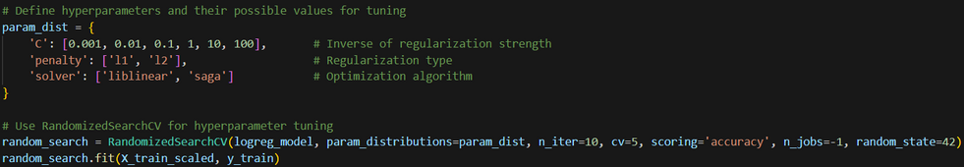
Model Improvements-HyperParameter
After viewing the evaluation for each model respectively, I am able to decide on how we want to change our hyperparameters for each of our models. Some examples are:
KNN: n_neighbours, weights,etc
SVC: C (regularization parameter), Kernel function, Gamma (RBF kernel parameter),etc
NB: Var_smoothing,class_weight,etc
RandomForest: n_estimators,max_depth,etc
LinearRegression: C,penalty,solver,etc

Slide 15
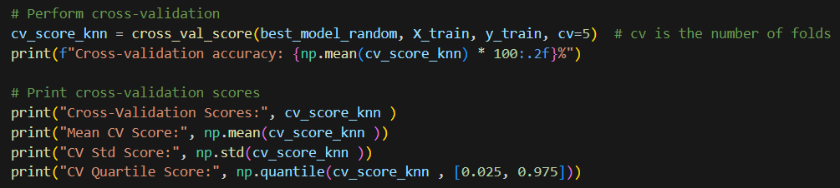
Model Improvements-Evaluation pt2
Do a randomized search over parameters, where each setting is sampled from a distribution over possible parameter values in order to tune the hyperparameter and then use the cross validation to check.
For example, in the case of the KNN model,
RandomizedGridSearch
Cross-Validation

Slide 16
Results
RandomForestClassifier has highest accuracy score of 65.40%
Accuracy represents the percentage of instances that the model correctly classified out of the total number of instances.
RandomForestClassifier has highest AUC score of 0.66
AUC measures the overall performance of a classifier across all classification thresholds..

Slide 17
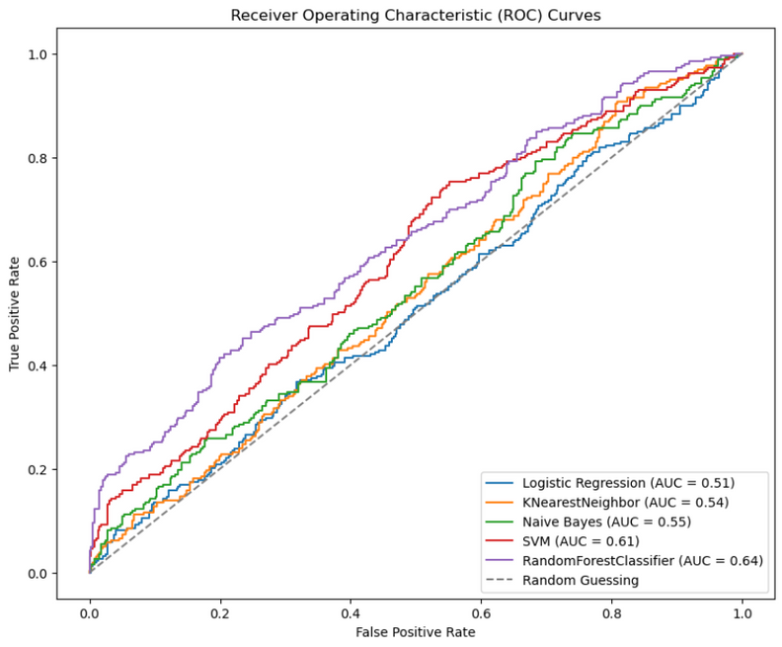
Results
An ideal ROC curve would hug the top-left corner of the plot, indicating that the model perfectly classifies all positive and negative cases.
A random classifier would produce a diagonal line, showing that it is no better than guessing at random.
A good classifier would have a curve closer to the top-left corner, indicating that it is better at distinguishing between positive and negative cases.
Therefore, since RandomForestClassifier has the most curved line closer to the top-left.
RandomForestClassifier has highest CV at 0.66.
If accuracy is used as the metric, a higher CV score indicates better performance

Slide 18


65.4%
Best Model to use
The best model to use would be the RandomForest Model.
With the highest AUC and accuracy score, combined with the fact that it has the highest cross validation score, shows that it is the best model to use to predict the water quality through classification
Accuracy Score
0.66
AUC Value
0.66
Cross-Validation Score

Slide 19
Conclusion
Classification is a task that machine learning can accomplish. It finds patterns and relationships within the data to accurately assign labels or categories to new, unseen data.
The success of classification models relies on careful feature selection, good training datasets and the correct algorithm model.

Slide 20

THANK YOU!
THE END

